Slide 1
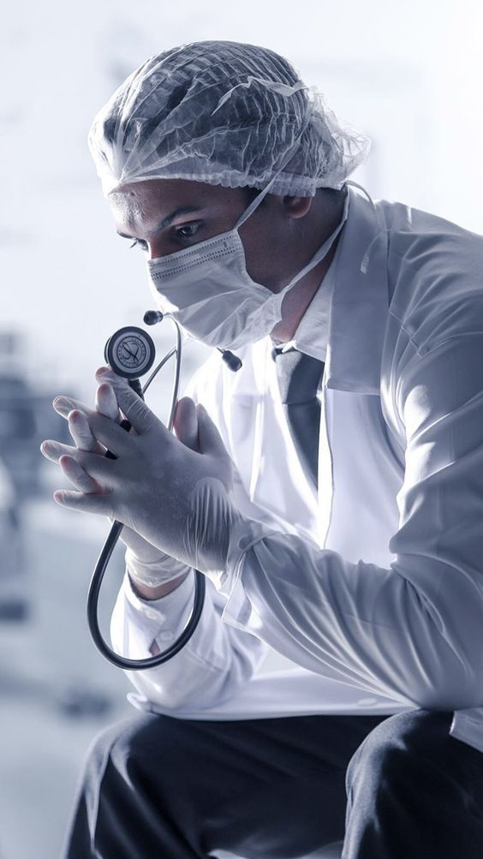

A benchmarking of object detection models for Urothelial Cancer cell detection
Facoltà di Ingegneria dell’Informazione, Informatica e Statistica
Corso di Laurea Magistrale in Data Science
Candidate
Tran Luong Bang
ID number 1956419
Thesis supervisor Co-Advisor
Dr. Scardapane Simone Dr. Giarnieri Enrico
Notes:
Today, I would like to present my master thesis “A benchmarking of Object Detection models for Urothelial Cancer cell detection”
under the supervision of Dr. Scardapane Simone and Co-Advisor Dr. Gianieri Enrico.

Slide 2
Introductions
Bladder Cancer
Fig 1: Number of new cases
in Italy, 2020
Fig 2: Number of new cases between
Men and Women in Italy, 2020
Fig 3: Types of Bladder Cancer
Notes:
As you may know, Bladder cancer is one of the most common cancers in the world. Italy is not excluded.
According to the Global Cancer Observatory, In 2020, there are over 28000 new cases in Italy.
The incidence of bladder cancer in Men is 4 times higher than in Women.
In which, Urothelial Carcinoma occupy 90% of all bladder cancers.
To diagnosis this cancer it requires qualified expert and time with different tests.

Slide 3
Introductions
By leveraging the power of deep neural networks, many problems have started to be explored based on medical imaging analysis, such as brain tumor segmentation.
However, some problems remain underexplored for several reasons,
especially the scarcity or non-existence of data.
Our motivation is to tackle one of these problems, which is detecting bladder tissue cancer at the cellular level
Notes:
In recent years, By leveraging the power of deep neural networks, many problems have started to be explored based on medical imaging analysis.
However, some problems remain underexplored for several reasons,
especially the scarcity or non-existence of dataset.
Our motivation is to tackle one of these problems, which is detecting bladder cancer at the cellular level.

Slide 4
Chapter 1
Object detection in Medical Images
Chapter 2
Methodology
Contents
Chapter 3
Dataset and Evaluation Metric
Chapter 4
Experiment Results
Notes:
We divided our presentation into 4 chapters.
Let’s start with the first chapter Object detection in Medical Image

Slide 5
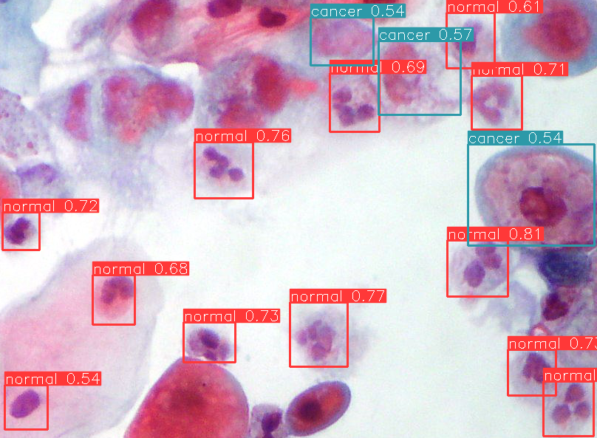
What is Object Detection?
Classification
Localization
Notes:
Object detection is a computer vision technique for locating instances of visual objects of certain classes in digital images.
It is a combination of object classification and object localization.

Slide 6
Challenges in Domain Problem
Object Localization
Privacy and Legal Issues
Multiple Aspect Ratios
Class Imbalance
Limited Data
Noise Labeling
Notes:
There are some challenges in this domain problem.
Such as localizing objects, detecting objects with various sizes and aspect ratios.
the Limited Data for training deep neural network,
The Privacy and legal issues to access the medical images.
High class imbalance and Noise Labeling.

Slide 7
Chapter 1
Object detection in Medical Images
Chapter 2
Methodology
Contents
Chapter 3
Dataset and Evaluation Metric
Chapter 4
Experiment Results
Notes:
In chapter 2, we introduce the algorithms for object detections.

Slide 8
Algorithms for Object Detection
Object Detectors (OD)
Traditional OD
DL based OD
VJ Detector
CNN-based OD
Transformer-based OD
HOG Detector
Two-stage OD
One-stage OD
Vision Transformer
DPM Detector
R-CNN
YOLO
Swin Transformer
Fast R-CNN
SSD
Faster R-CNN
RetinaNet
Notes:
There are many object detection models. Apart from traditional detectors, there have been several generations of CNN based object detectors which can be divided into two-stage and one stage approach. Recently, we saw the increase of interest in new class of object detector which is based on the Transformers.
So one of the aims of this thesis is to benchmark these architectures which are highlight in the red rectangle.

Slide 9
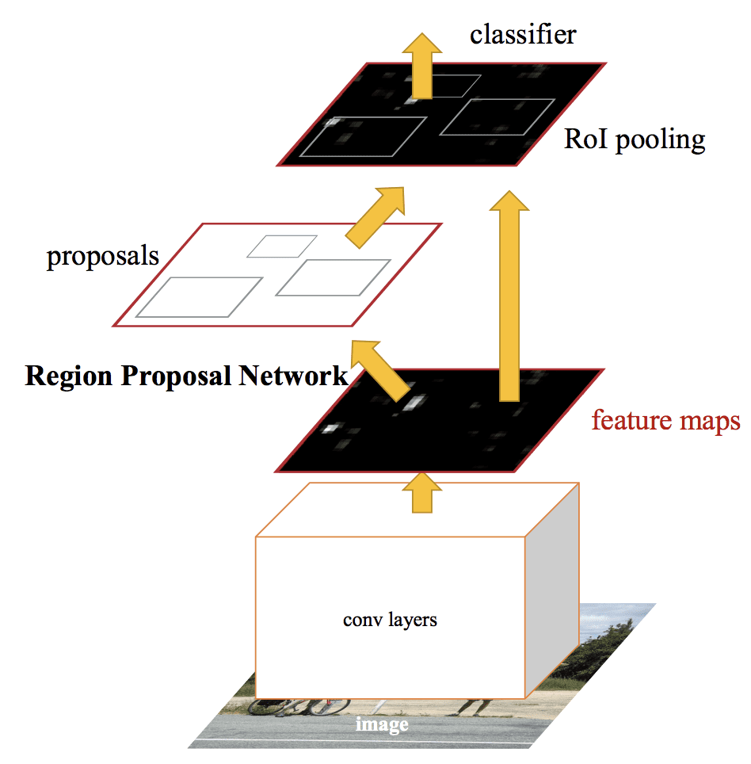
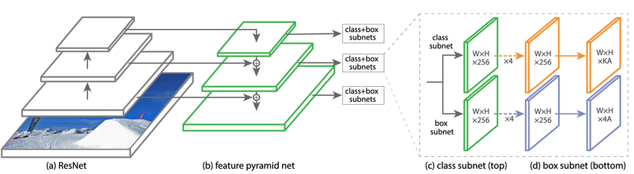
CNN-based Object Detectors
Two-stage object detector
Faster R-CNN by Shaoqing Ren et al.
One-stage object detector
RetinaNet by Tsung-Yi Lin et al.
Notes:
So CNN based object detectors are state-of-the-art in most applications such as using yolo for real time detection.

Slide 10
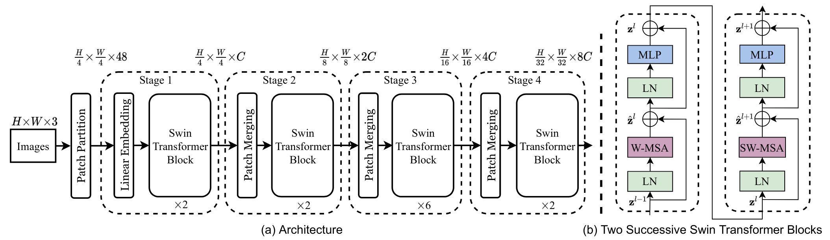
Transformer-based Object Detectors
Swin Transformer by Ze Liu et al.
Notes:
Instead, Transformer based model are new class, because they are not build on CNN, but on Transfomers which origonal come from natural language processing. The key difference is the images is split in patches considered as the sequence of token.. Among them,
one of the most successful variant of object detection which is called Swin transformer. With the matter of time, I am able go into details of each architectures.

Slide 11
Chapter 1
Object detection in Medical Images
Chapter 2
Methodology
Contents
Chapter 3
Dataset and Evaluation Metrics
Chapter 4
Experiment Results
Notes:
In this chapter, we introduce the dataset and Evaluation metric

Slide 12
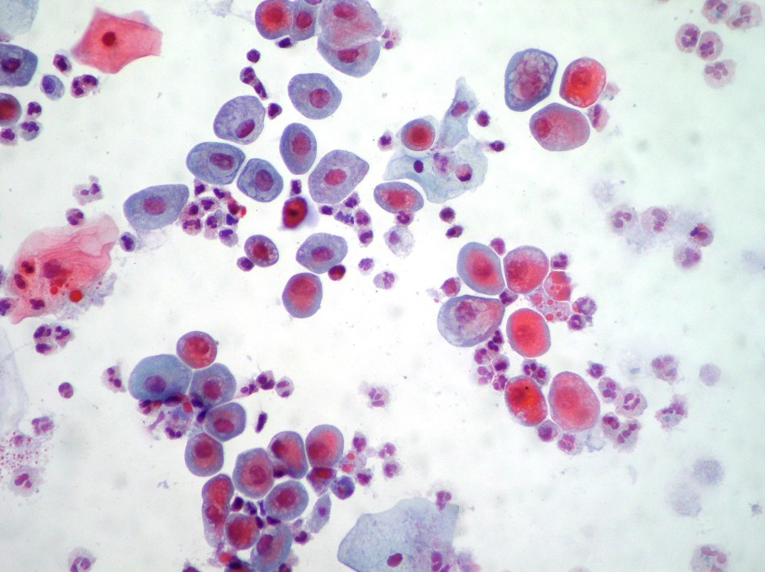
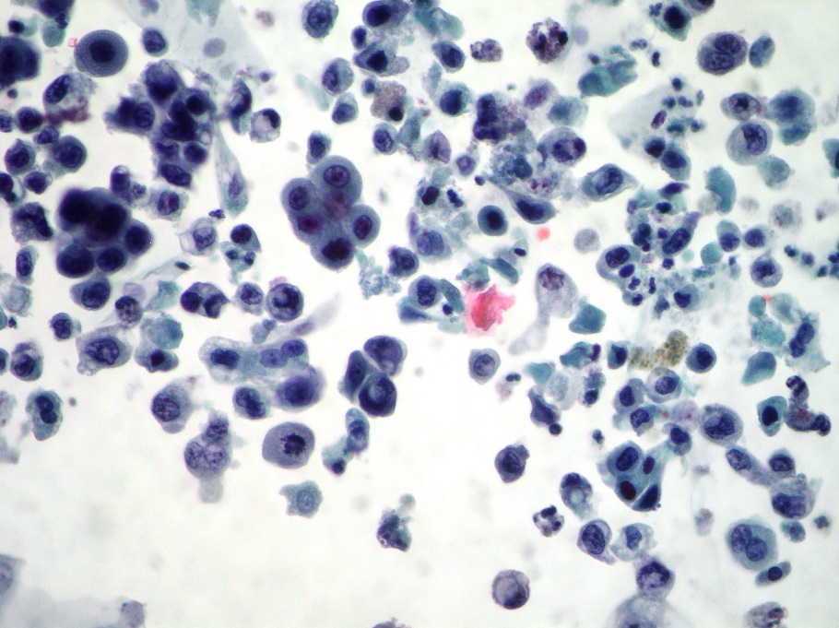
Data Collection
A novel urothelial cancer cell object detection dataset
Sant’ Andrea General Hospital in Rome
and Sapienza University of Rome
81 images with a size of 1712x2288 pixels
from 81 patients
Dataset is annotated in COCO format
Notes:
The urothelial cancer cell object detection dataset is collected by the coblaboration of Sant’Andrea General Hosttal in Rome and Sapienza University of ROme,.
It include 81 images from 81 patients. The Dataset is annotated in COCO format.

Slide 13
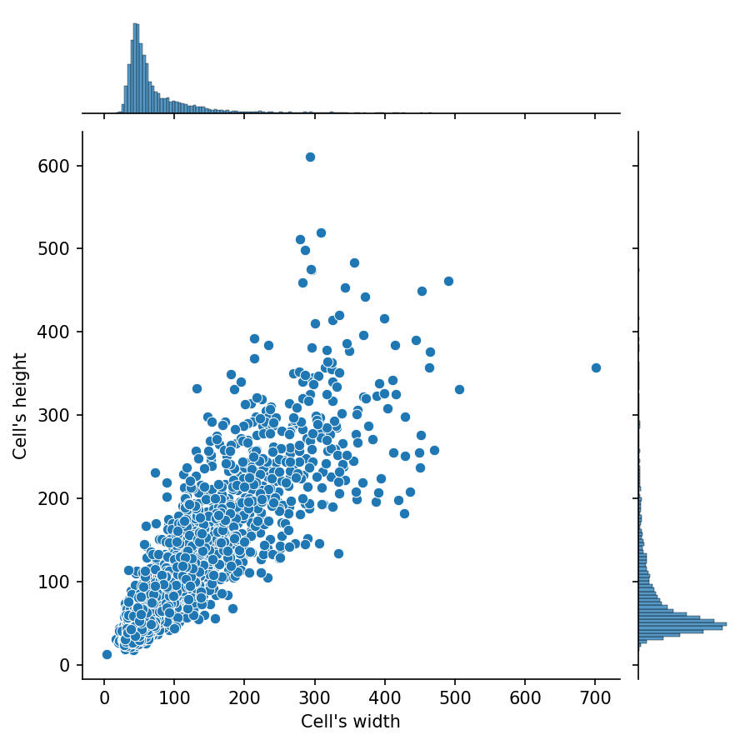
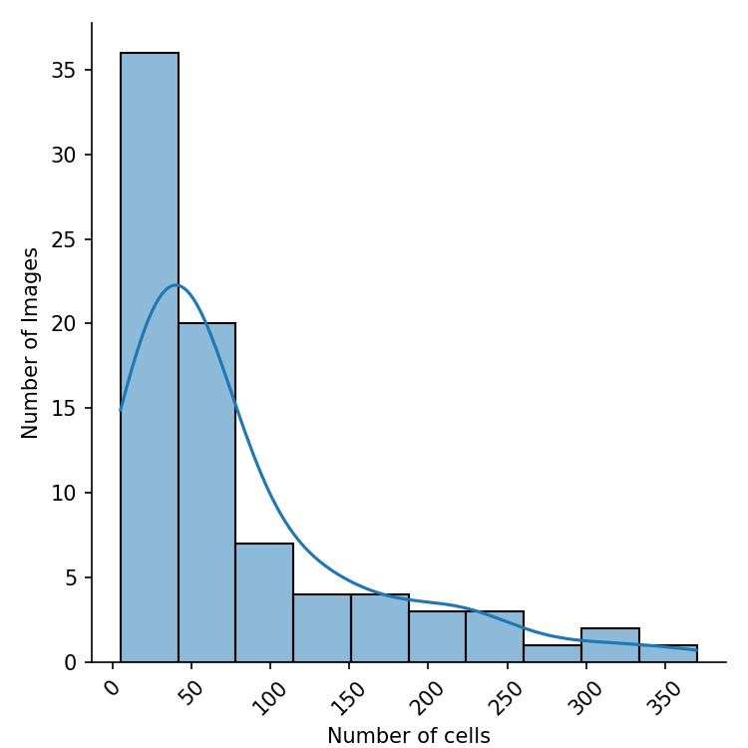
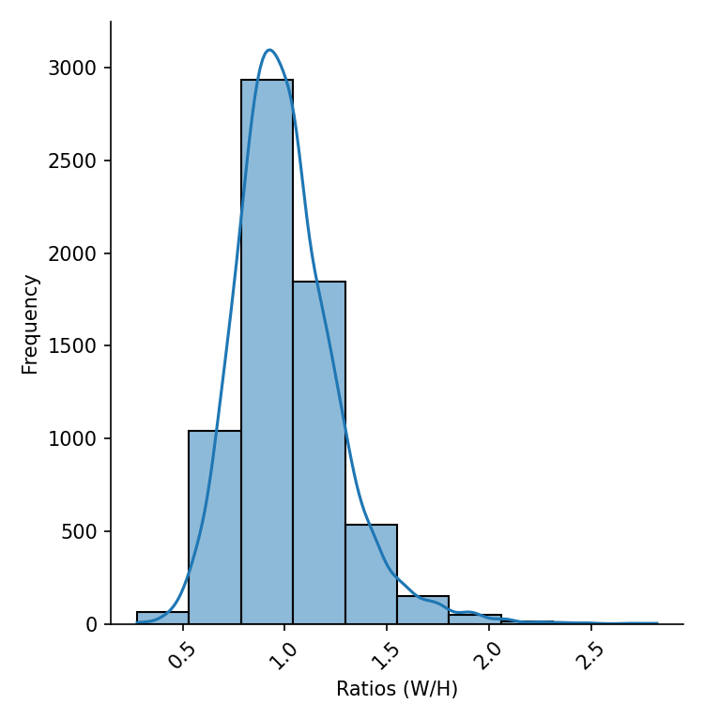
Data Exploration
Fig 4: Distribution of number of cells across images
Fig 5: Distribution of Cell’s height and width
Fig 6: The frequency of cells according to ratios (W/H)
Notes:
As we can see in Fig:4. the number of cells varies significantly ranging from 5 to 370 cells in each image.
Shown in Fig 5: the majority of cell’s width and height are distributed from 40 to 150 pixels.
Shown in Fig 6: the majority of the cell’s ratio ranges between 0.5 and 2

Slide 14
Data Processing
Original Dataset with 6 classes
Dataset 1
Dataset 2
Normal
Normal
Cancer
Cancer
Suspected Cancer
Notes:
From the original dataset with 6 classes, we create 2 new datasets:
Dataset 1 with 2 classes Normal and Cancer,
Dataset 2 with 3 classes Normal, Cancer and suspected Cancer.
normale epiteliali, normale infiammatorie,normale globuli rossi, patologico atipico, patologico sospetto, patologico carcinoma.

Slide 15
Data Processing
Dataset | # Images | % Images | # Cells | % Cells | Average # cells per image
Train | 65 | 80.25% | 5215 | 78.64% | 80.23
Validation | 12 | 14.81% | 1024 | 15.44% | 95.33
Test | 4 | 4.94% | 392 | 5.91% | 98
Data Splitting
Images | Image Size | Train dataset | Validation dataset | Test dataset
Original Images | 1712x2288 | 65 | 12 | 4
Sliced Images 1 | 224x224 | 2292 | 346 | 4
Sliced Images 2 | 640x640 | 806 | 132 | 4
Slicing images
Notes:
We split dataset into 3 partitions train based on number of image and cells, around 80% for training, 15% for validation and 5% for testing.
To detect small and dense objects in high-resolution images of our dataset and increasing number of train images,
we train and evaluate the model on images with smaller size by slicing original image.

Slide 16
Data Processing
Class Imbalance
Notes:
There is a high class imbalance in 2 dataset shown here. To deal with this problem, we use the Focal Loss.

Slide 17
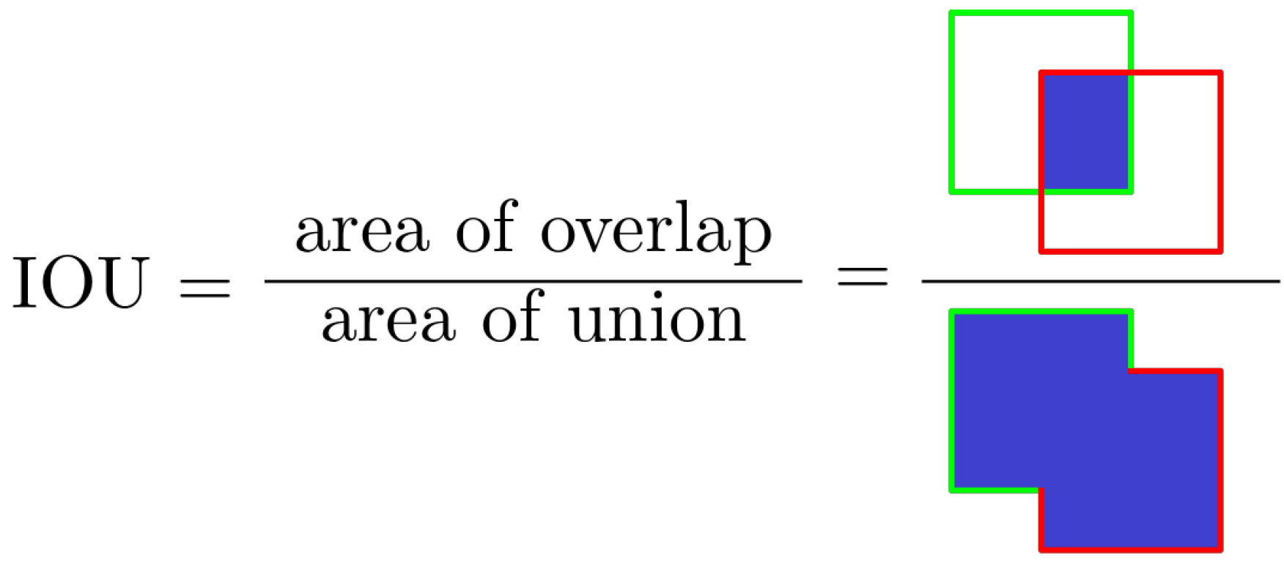
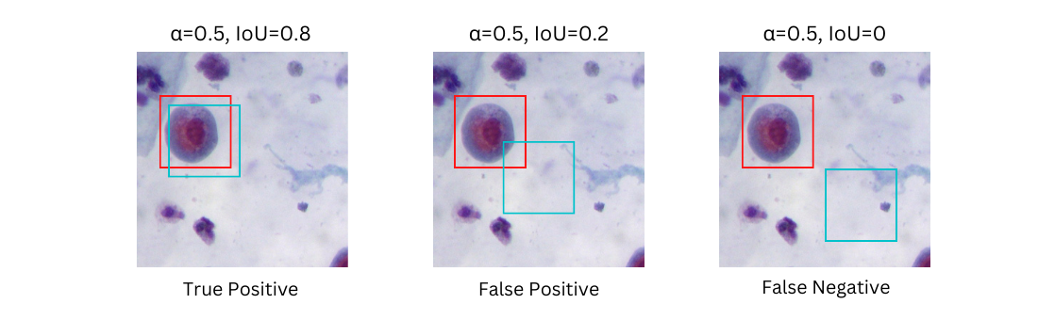
Evaluation Metrics
Intersection over Union (IoU)
Notes:
IoU is the metric that measure the overlap degree between the prediction and ground truth.
We use this IoU and a threshold alpha to identifify the TP, FP, FN.

Slide 18
Evaluation Metrics
COCO mAP
Model | mAP | AP₅₀ | AP₇₅ | AP_{S} | AP_{M} | AP_{L}
AP is the average Precision over multiple IoU
- mAP : AP at IoU = 0.50:.05:0.95 (use to determine the best model)
AP₅₀ : AP at IoU = 0.5
AP₇₅ : AP at IoU = 0.75
AP Across Scales:
AP_{S} : AP for small objects: area < 32²
AP_{M} : AP for medium objects: 32² < area < 96²
AP_{L} : AP for large objects: area > 96²
Notes:
To evaluate the model performance,
we use the CoCO Avarage Precision which include AP over multiple IoU and AP across scales,
In which mAP is used to determine the best model.

Slide 19
Chapter 1
Object detection in Medical Image
Chapter 2
Methodology
Contents
Chapter 3
Dataset and Evaluation Metric
Chapter 4
Experiment Results
Notes:
In this chapter 4, we are gonna show our experiment results.

Slide 20
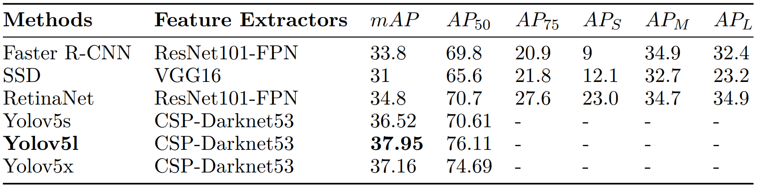
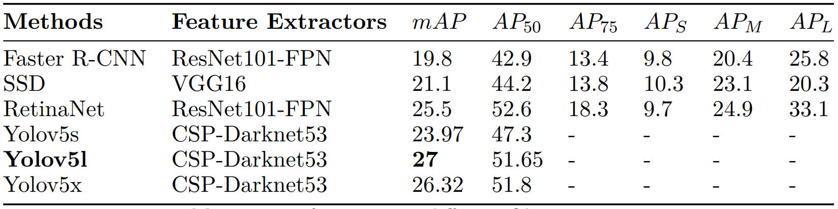
Experiment Results
Performance on different Object Detectors
Dataset 1
Dataset 2
Notes:
In this slide, we can see the performance of different object detectors.
Compared with other objectors, Yolov5l outperforms on both dataset 1 and dataset 2 with the value of 37.95 and 27 mAP, respectively.

Slide 21
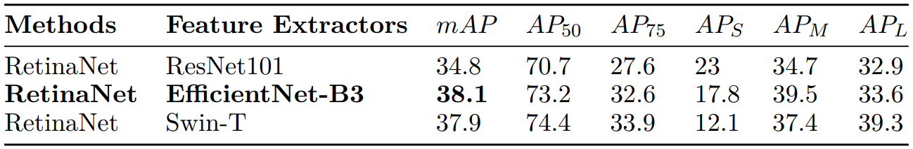
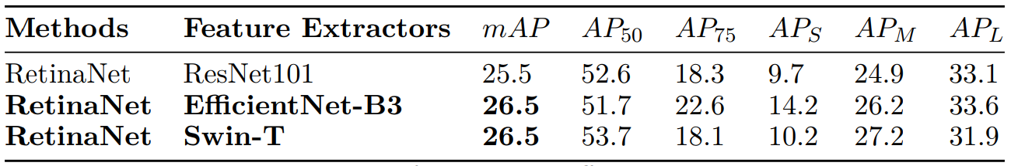
Experiment Results
Performance on different Feature Extractors
Dataset 1
Dataset 2
Notes:
Considering the impact of feature extractors in this computer vision task,
we implemented the RetinaNet with different backbone network.
In Dataset 1, model with EfficientNet reach the highest value of 38.1 mAP.
Meanwhile in Dataset 2, models with EfficientNet and Swin Transformer achieve the same value of 26.5 mAP.

Slide 22
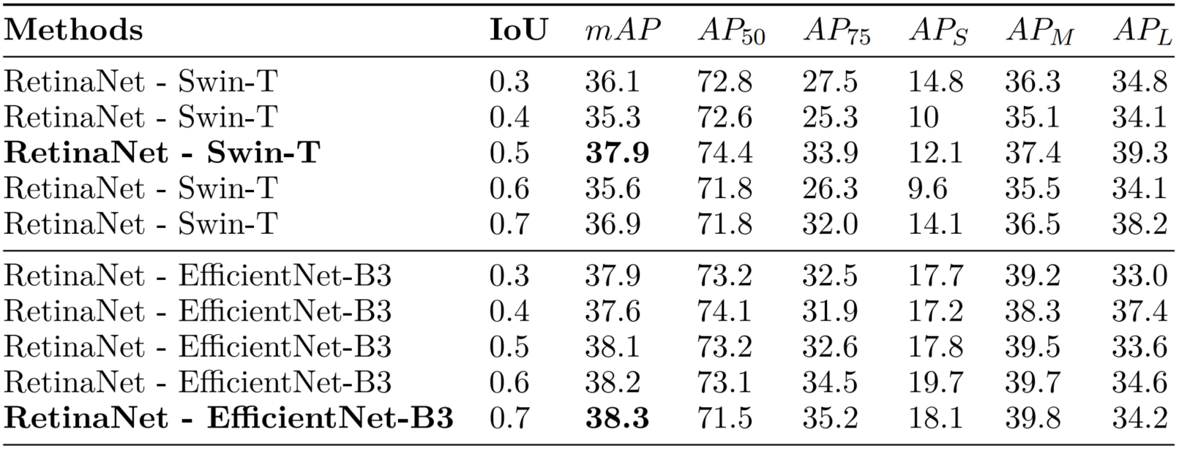
Experiment Results
Performance on different IoU thresholds in Non-Maximum Suppression (NMS)
Dataset 1
Notes:
Considering IOU threshold defines overlapping bounding boxes during the NMS technique.
We evaluate the model performance on five IoU thresholds.
In Dataset 1, the model with EfficientNet backbone acchieved highest value of 38.3 mAP with IoU threshold 0.7
NMS technique is used to filter the predictions of object detectors because 1 object can be detected with multiple overlapping bounding boxes.

Slide 23
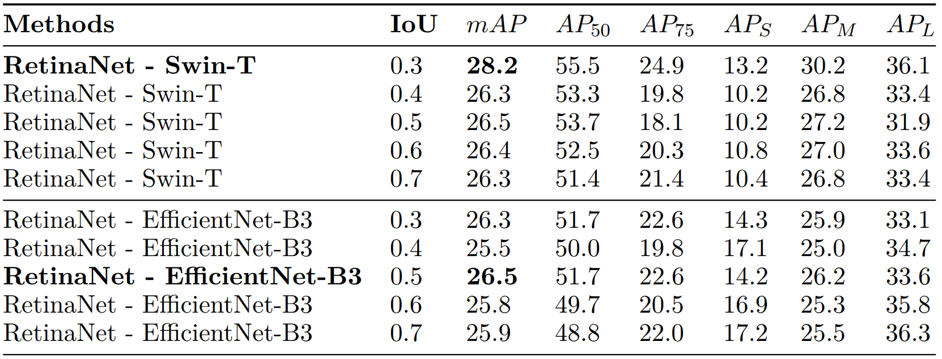
Experiment Results
Performance on different IoU thresholds in Non-Maximum Suppression
Dataset 2
Notes:
By contrast, in Dataset 2, RetinaNet model with Swin transformer with IoU threshold 0.3 outperform with 28.2 mAP.

Slide 24
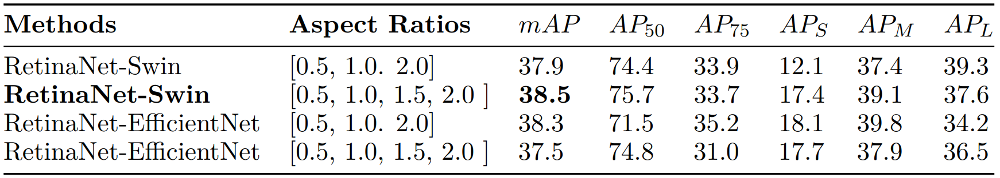
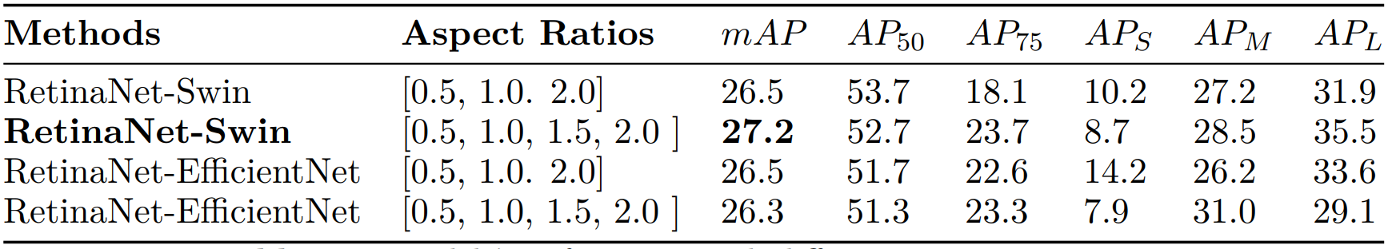
Experiment Results
Performance on different Aspect Ratios
Dataset 1
Dataset 2
Notes:
Comparing with default setup, we add an additional aspect ratios 1.5
As the result shown, in both dataset, with four aspect ratios,
RetinaNet-Swin reached the highest performance of 38.5 and 27.2 mAP.

Slide 25
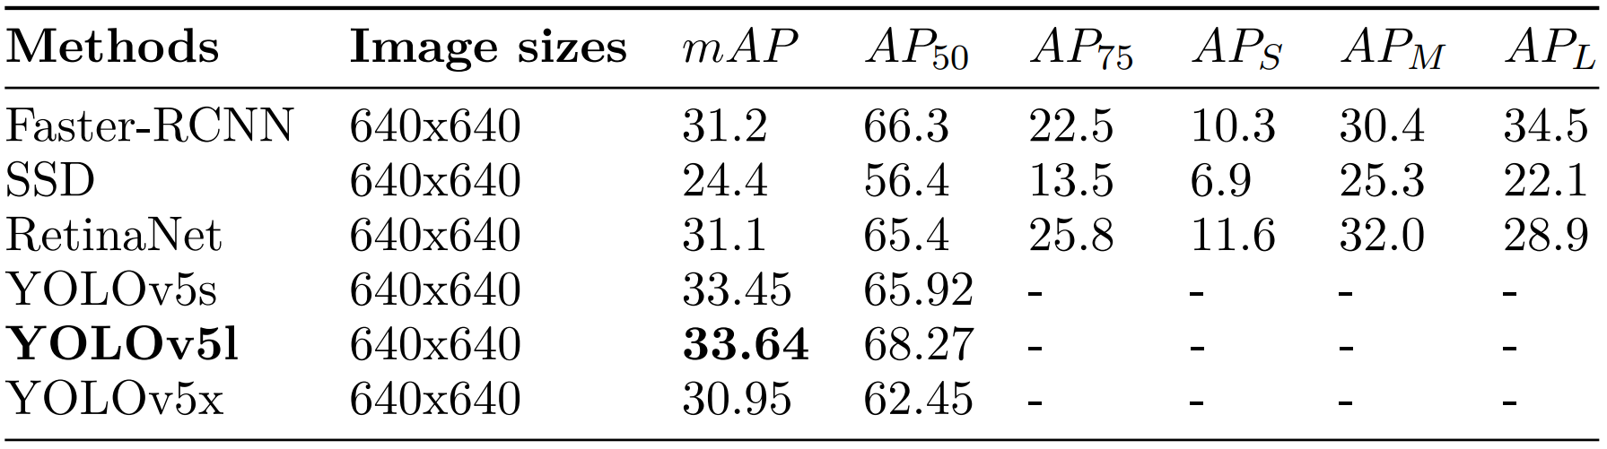
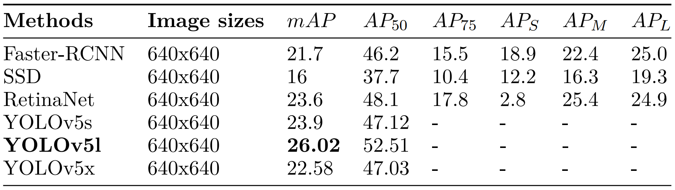
Experiment Results
Performance on bigger image sizes
Dataset 1
Dataset 2
Notes:
We also evaluate the model performance on images with bigger sizes.
As the results shown, YOLOv5l outperforms other object detectors mentioned,

Slide 26
Experiment Results
The Best Models
Dataset 1
Dataset 2
Notes:
At the end, after fine tuning diffirent hyperparamters of model we found 2 best performance model on dataset 1 and dataset 2.
The best model for dataset 1 is RetinaNet with Swin Transformer backbone, 4 aspect ratio and IoU threshold of 0.5.
The best model for dataset 2 is RetinaNet with Swin Transformer backbone, 3 aspect ratio and IoU threshold of 0.3.

Slide 27
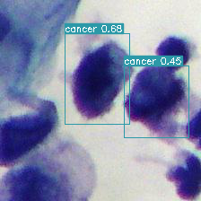
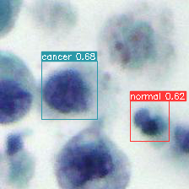
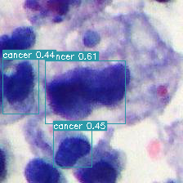
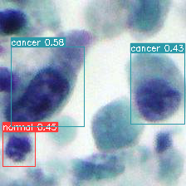
Inference Results
Detection Result on sliced images of a test image
Notes:
To inference on the test image with big size, we perform inference on smaller sliced image before integrating the sliced predictions on the original image.

Slide 28
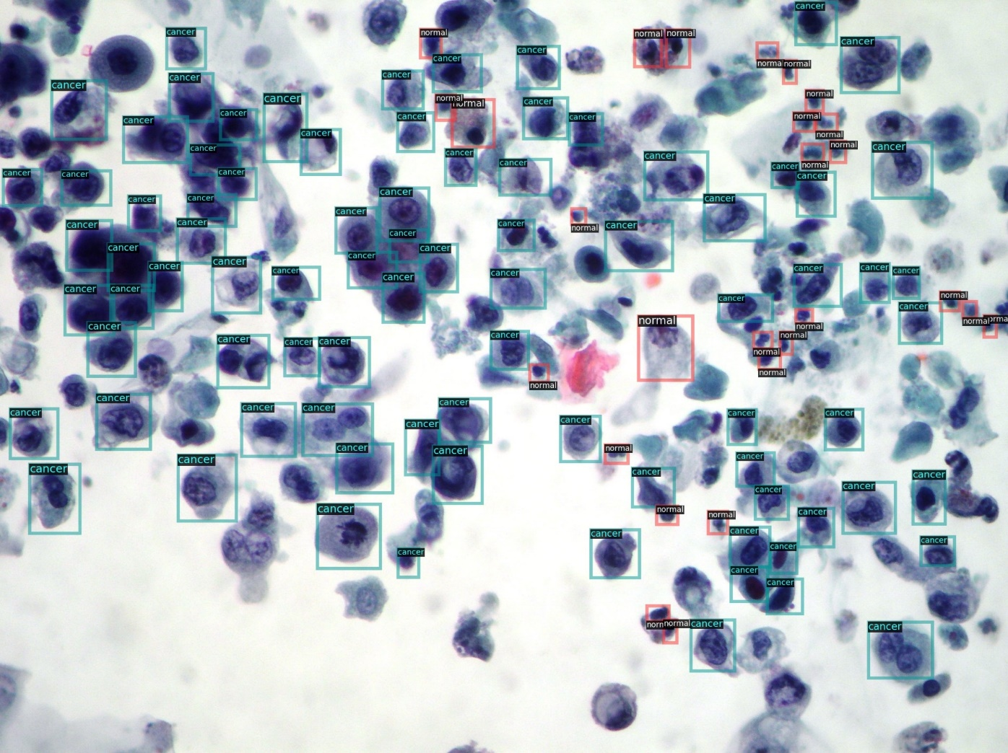
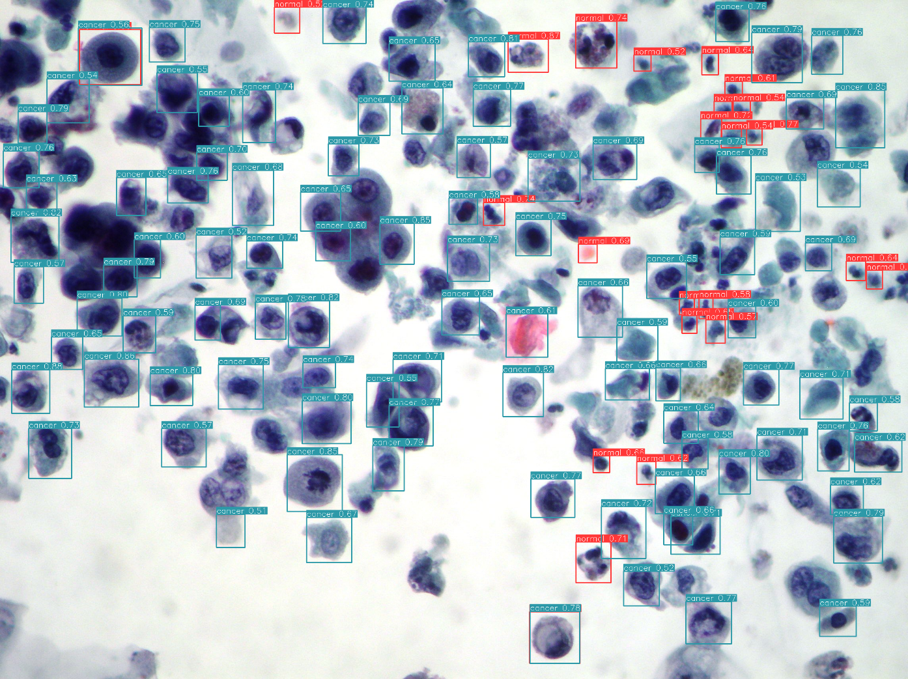
Inference Results
Detection Result of model 1 trained on Dataset 1
Ground Truth
Prediction
Notes:
Here is a detection result of the test image by using best model 1.

Slide 29
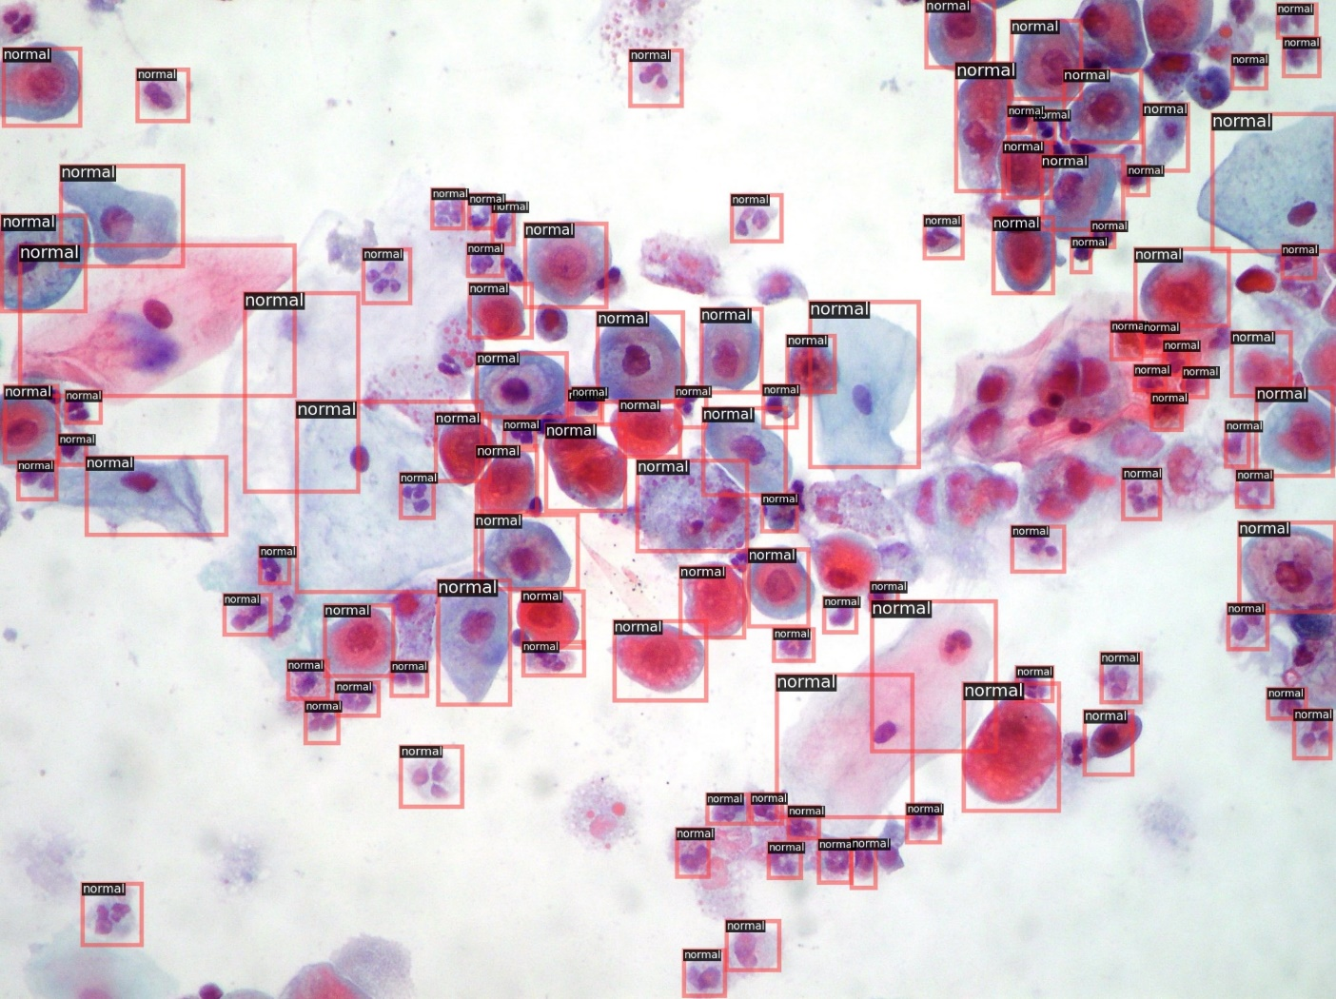
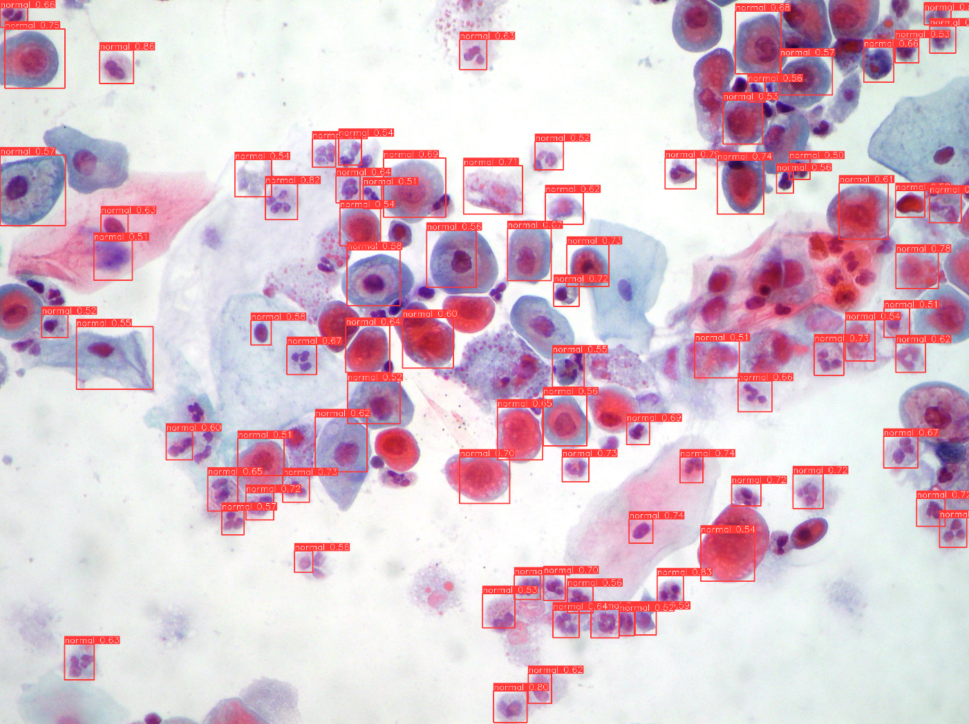
Inference Results
Detection Result of model 2 trained on Dataset 2
Ground Truth
Prediction
Notes:
Here is a detection result of the test image by using best model 2.

Slide 30
Conclusion
We provided a novel urothelial cancer cell object detection dataset which is a real-world dataset where we
find some problems such as class imbalance, small-scale dataset, small dense objects and noise labeling.
We experimented to build models which can detect the small urothelial cancer cells in big image size.
We provided a scientific benchmark of the state-of-the-art object detection architectures training on this dataset.
We evaluated the capability of Transformers and CNNs in object detection tasks.
Notes:
In conclusion, In this study, we provided a novel urothelial cancer cell object detection dataset which is a real-world dataset where we
find some problems such as class imbalance, small-scale dataset, dense objects and noise labeling.
Second, we built models which can detect the urothelial cancer cells in high-resolution images,
Moreover, we also provided a scientific benchmark of the state-of-the-art object detection architectures training on this dataset.
Finally, we evaluated the capability of Transformers and CNNs in object detection tasks

Slide 31
Feature Works
More in-depth investigations and efforts in data collection should be made to build a big and reliable dataset for this problem.
More extensive and comprehensive research undertaking to address the issue of detecting urothelial cancer cells.
A new benchmark with new cutting-edge models such as YOLOv7, ConvNeXt, etc.
Notes:
For the future work, we want to have more

Slide 32
Thank you for your attention!

